Slide 1
Project Background
Inspired by Hollow Knight
Want to create an immersive game
Want to get better at coding in C# (2D games)
Want to learn how to implement OOP into games.

Slide 2
Existing Applications
Hollow Knight
Celeste
Ori and the Will of the Wisps

Slide 3
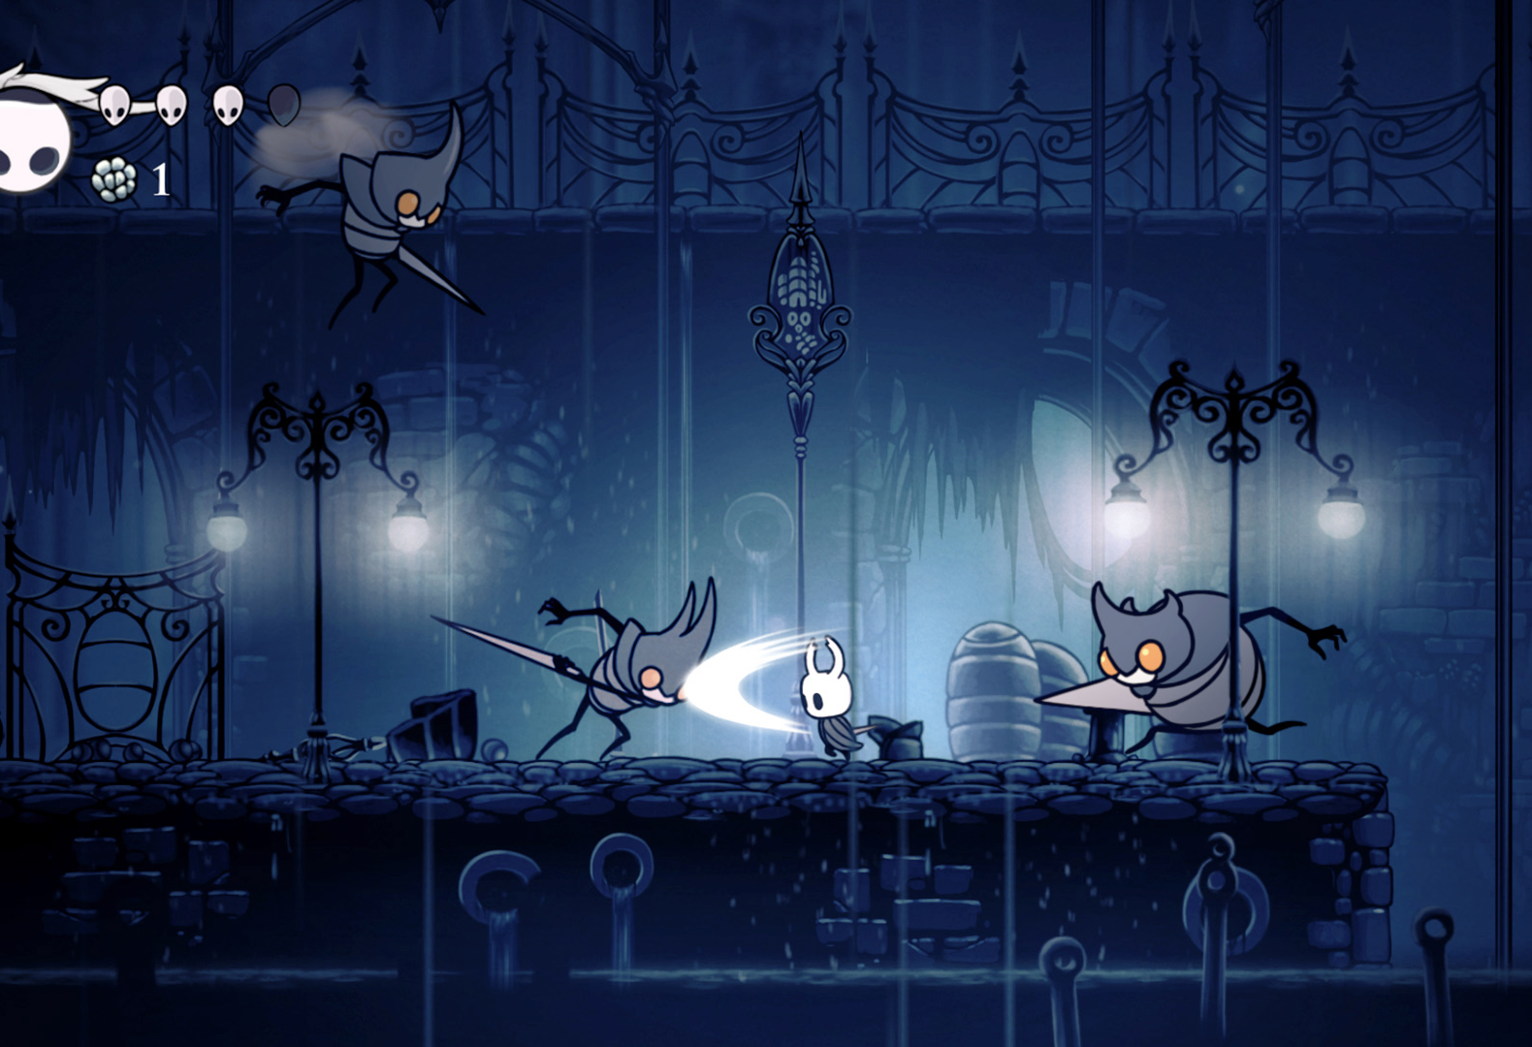
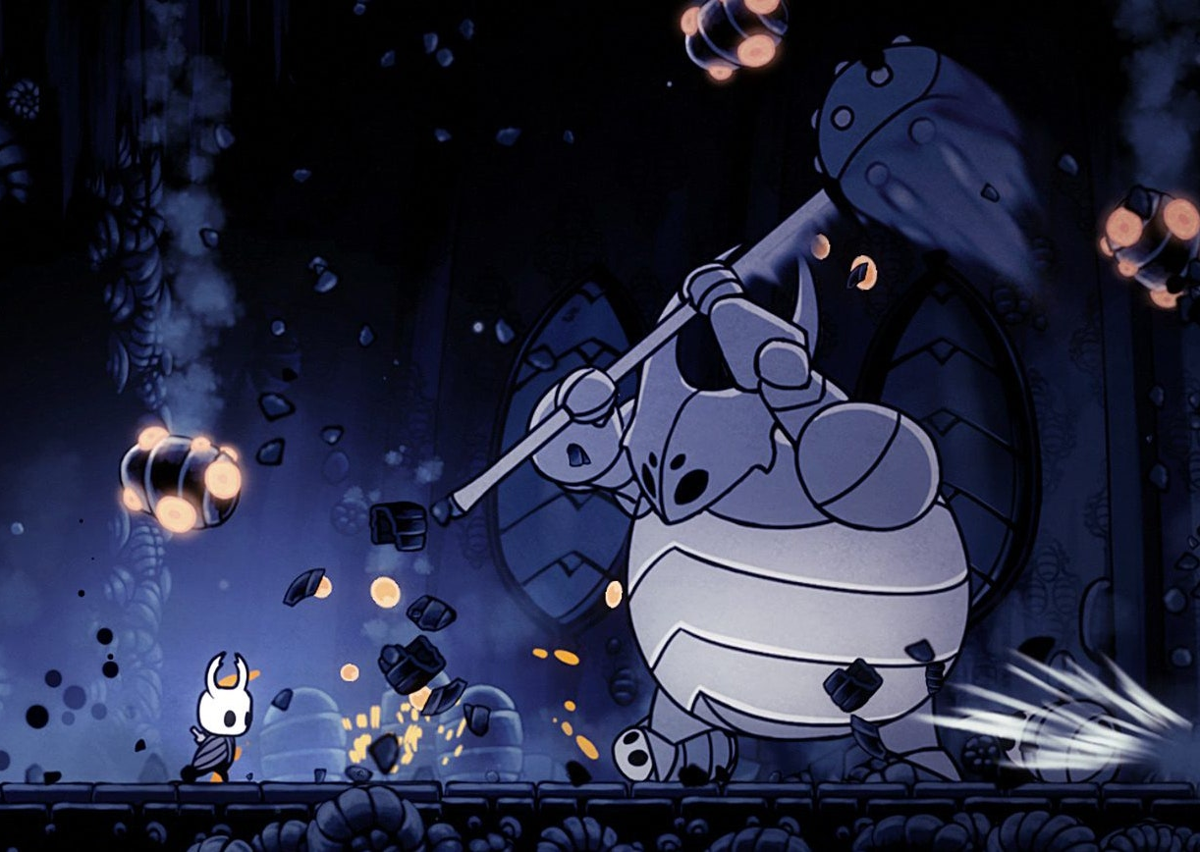
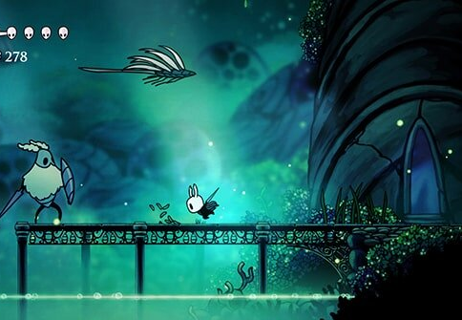
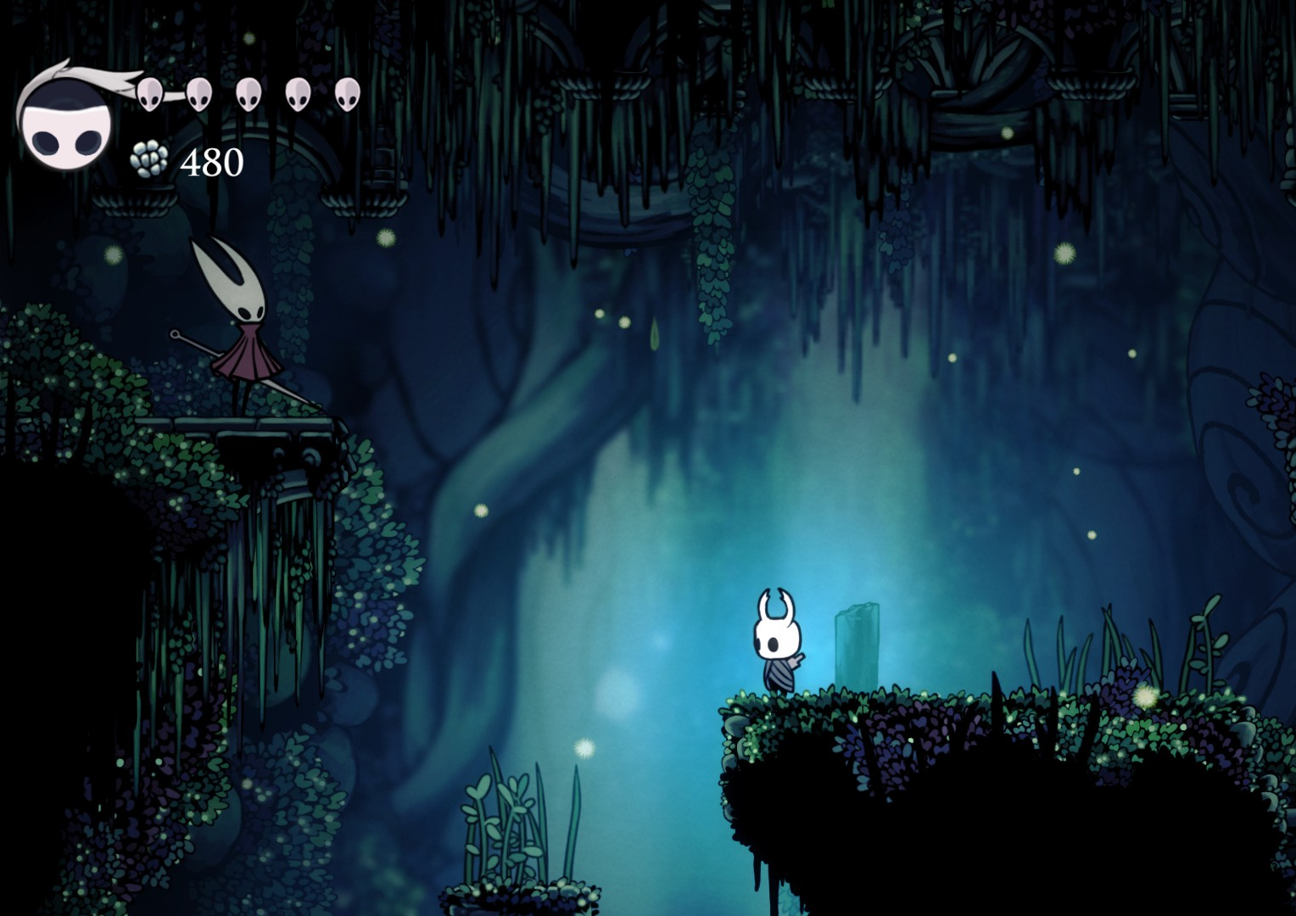
Hollow Knight
Many Optional Boss Fights
Many different types of enemies.
Beautiful environment
Lighting
Fun but challenging combat

Slide 5
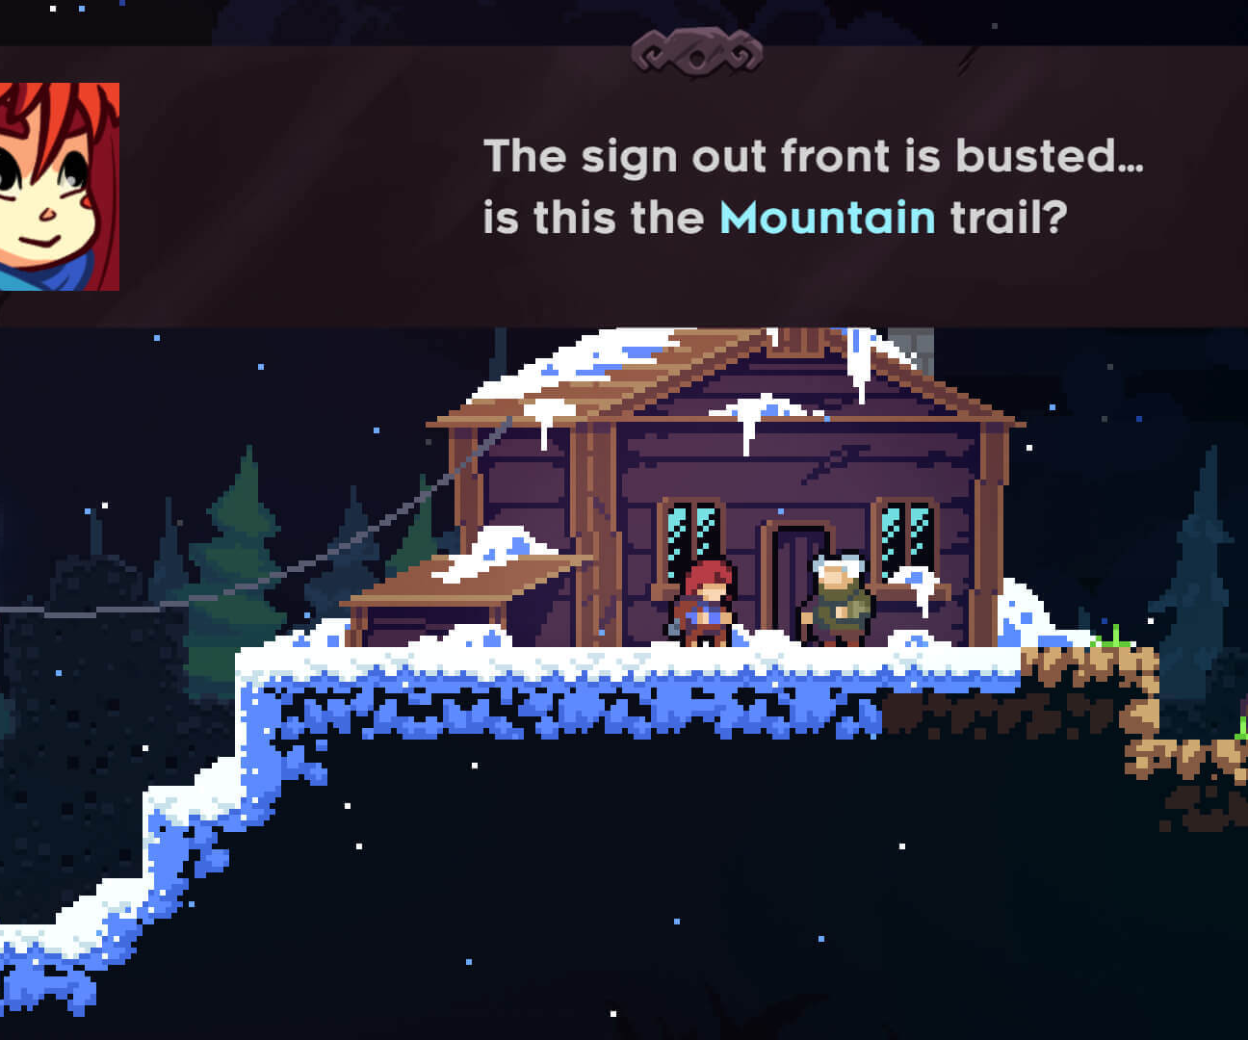
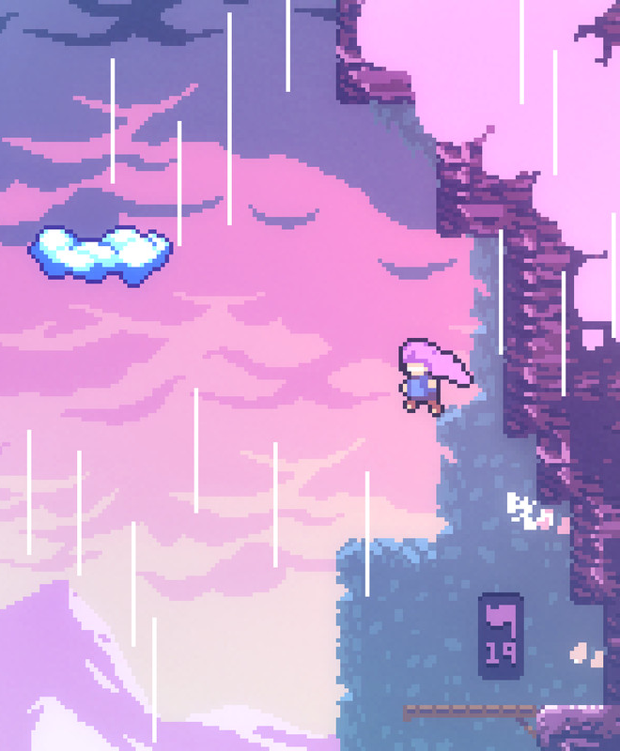
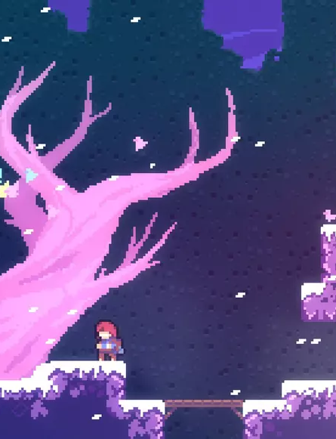
Celeste
Platformer
Jumping puzzles
Story focused

Slide 6
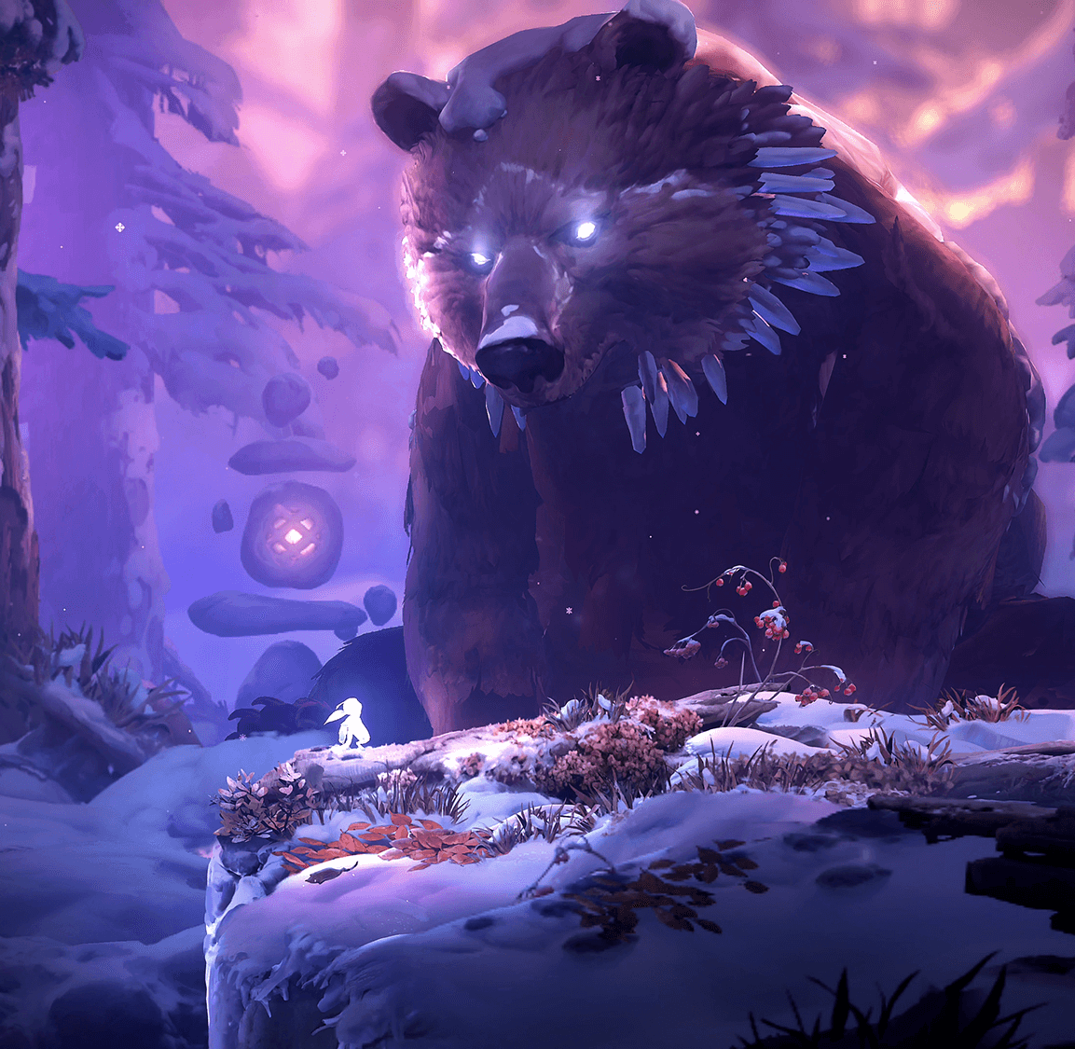
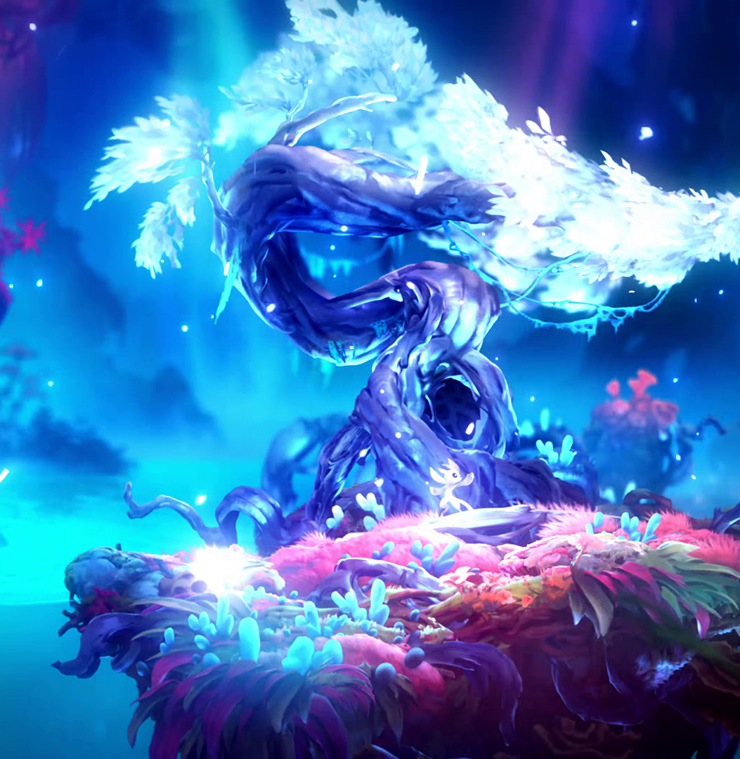
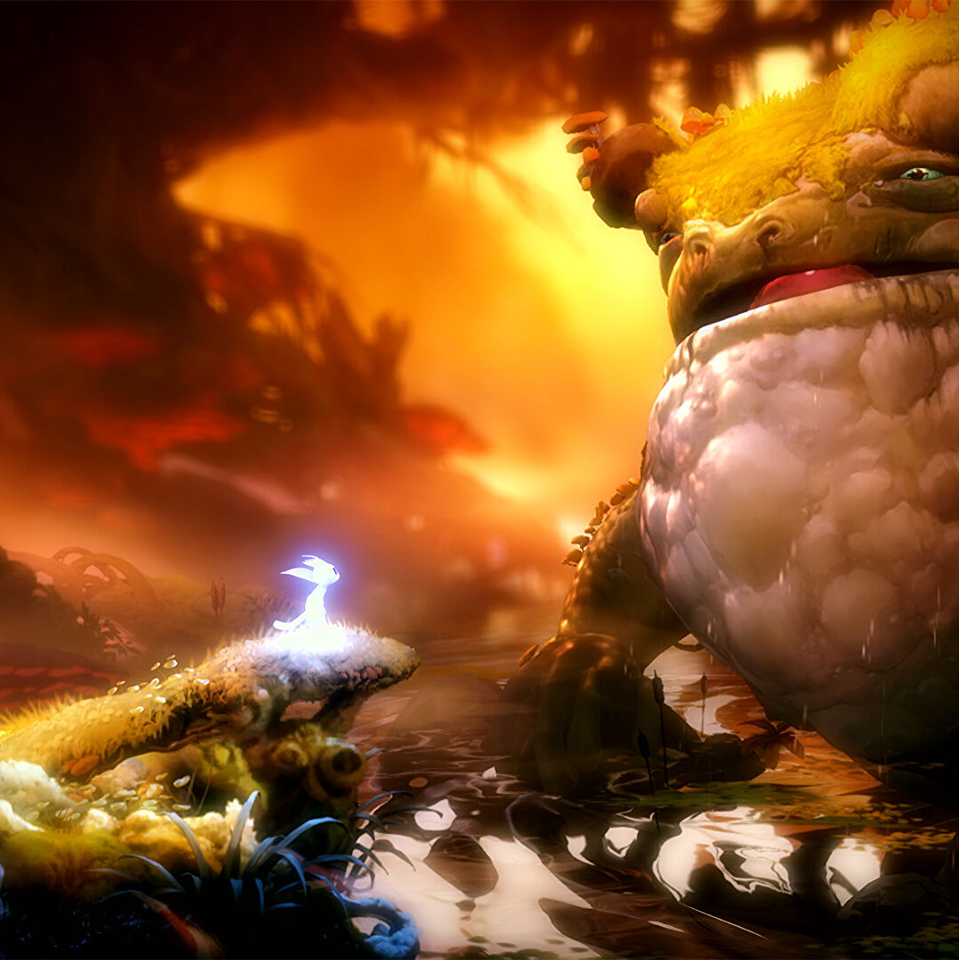

Ori and the Will of the Wisps
Unique combat (each hit carries a lot of weight)
Unique ability upgrades e.g., slingshot for movement, and multiple attack moves

Slide 7
Research
Object Oriented Programming

Slide 8
Technologies

Slide 9
Implementation Plan

